Slide 1

Airplane Crash Analysis
By Archie Chadha
This Photo by Unknown author is licensed under CC BY-NC-ND.

Slide 2

CONTENT
Problem Statement
Objective
Data Cleaning
Fatality Analysis
Temporal Analysis
Geospatial Analysis
Analysis Conclusions

Slide 3

PROBLEM STATEMENT
This internship project aims to analyze airplane crashes and fatalities spanning from 1980 to 2023, using Power BI for interactive visualizations and insights.
By examining crucial data such as crash dates, locations, operators, flight details, aircraft types, and fatality statistics, the goal is to uncover patterns, contributing factors, and trends in aviation incidents. Ultimately, this analysis seeks to provide stakeholders with an actionable insights to enhance aviation safety and mitigate risks.
This Photo by Unknown author is licensed under CC BY-NC-ND.

Slide 4
DATA CLEANING AND TRANSFORMING
In preparation for our airplane crash analysis, we meticulously cleaned and transformed our dataset to ensure accuracy and reliability. This involved addressing missing values, standardizing date formats, parsing location data, categorizing variables, calculating derived metrics, identifying outliers, creating calculated columns, removing duplicates, and conducting data quality checks. These efforts have resulted in a robust dataset that forms the basis of our analysis, enabling us to derive meaningful insights and make informed decisions regarding aviation safety.

Slide 5
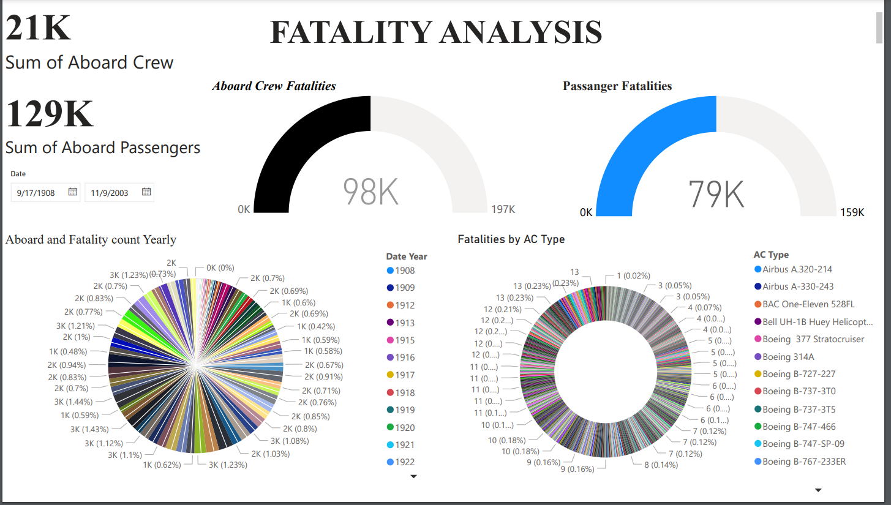

Slide 6
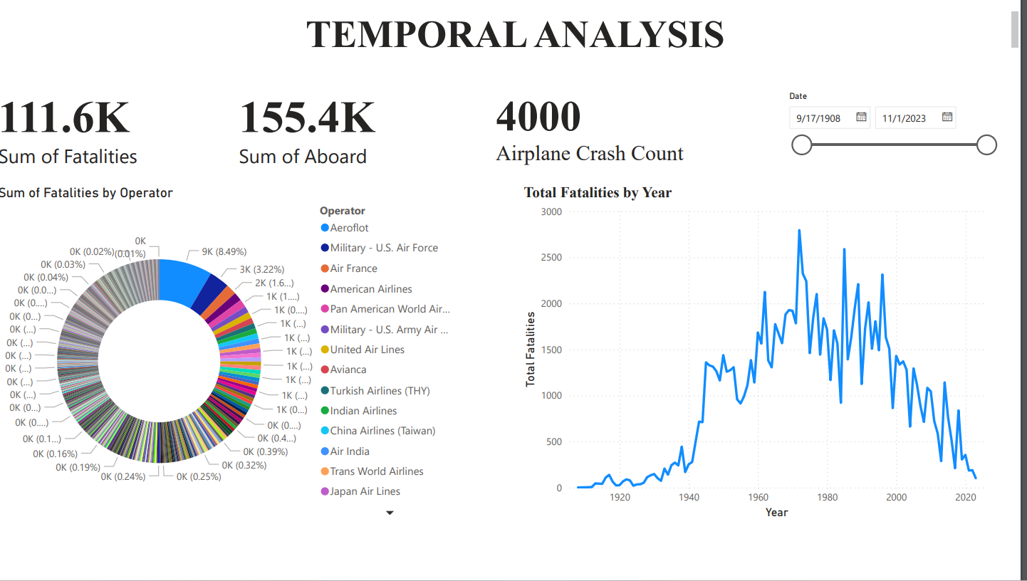

Slide 7
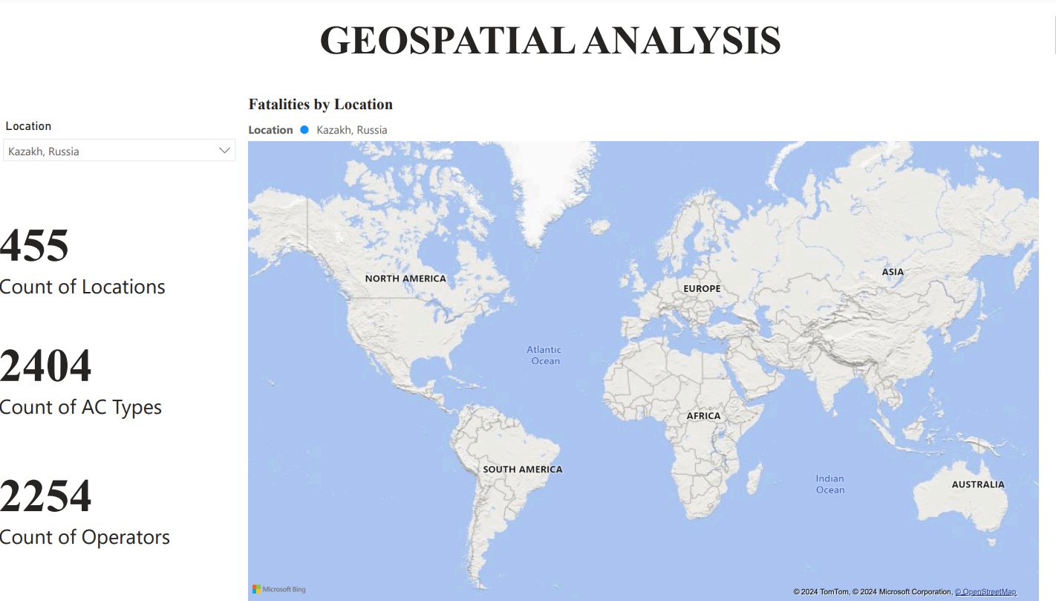

Slide 8

CONCLUSION
The analysis included the percentage of crew (16%) and passenger (84%) fatalities, providing a deeper understanding of the distribution of fatalities within the aircraft.
Chicago O'Hare, Illinois was the highest airplane fatalities rate in the world with 271 individuals
The year 2001 was the highest airplane fatalities rate in the world.
AC Type: McDonnell Douglas DC-10-10 and the number of fatalities, as it represents the cause of7% of fatalities.

Slide 9

THANKYOU!

